Slide 1
Classical Logics
Logic for Artificial Intelligence
Yi Zhou

Slide 2
  Content
    Classical logics
    Classical reasoning
    Modern SAT solving
    Applications
    Difficulties

Slide 3
  Content
    Classical logics
    Classical reasoning
    Modern SAT solving
    Applications
    Difficulties

Slide 4
What is Classical Logic
    Representation
        Statements as formulas
        Connectives (can be nested)
    Formal Semantics
        statements: true or false
        Connectives: inductive definition
    Reasoning
        From statements to statements
        Axiom systems

Slide 5
Categories
    Basic classical logics
        Propositional logic, first-order logic
    Extensions
        Situation calculus, modal logic, epistemic logic, dynamic logic, SMT, high-order logic, temporal logic, probabilistic logic, spatial reasoning, Hoare logic, separation logic...
    Alternations
        Nonmonotonic logic, rules, relevance logic, conditional logic …
    Restrictions
        Horn logic, OBDD, description logic …

Slide 6
  Content
    Classical logics
    Classical reasoning
    Modern SAT solving
    Applications
    Difficulties

Slide 7
Classical reasoning
Whether a formula is a consequence of a set of formulas
    Propositional logic
      truth table/random walk
      axiom system/natural deduction
      resolution
    Horn logic
      Forward chaining
    First-order logic
      grounding
      theorem prover
      model checker
    Others
      various solvers, e.g., SMT

Slide 8
Horn Logic - Definition
A Horn clause is a sentence of the form:
  (∀x) P₁(x) ∧ P₂(x) ∧ ... ∧ P_{n}(x) → Q(x)
where
  there are 0 or more P_{i}s and 0 or 1 Q
  the P_{i}s and Q are positive (i.e., non-negated) literals
Equivalently: P₁(x) ∨ P₂(x) … ∨ P_{n}(x) where the P_{i} are all atomic and at most one of them is positive
Prolog is based on Horn clauses
Horn clauses represent a subset of the set of sentences representable in FOL

Slide 9
Horn Logic - Examples
Special cases
  P₁ ∧ P₂ ∧ … P_{n} → Q
  P₁ ∧ P₂ ∧ … P_{n} → false
  true → Q
These are not Horn clauses:
  p(a) ∨ q(a)
  (P ∧ Q) → (R ∨ S)

Slide 10
Horn Logic - Reasoning
Proofs start with the given axioms/premises in KB, deriving new sentences using GMP until the goal/query sentence is derived
This defines a forward-chaining inference procedure because it moves “forward” from the KB to the goal [eventually]
Inference using GMP is complete for KBs containing only Horn clauses

Slide 11
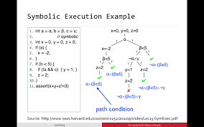
Satisfiability Modulo Theories (SMT)

Slide 12
  Content
    Classical logics
    Classical reasoning
    Modern SAT solving
    Applications
    Difficulties

Slide 13
  Content
    Classical logics
    Classical reasoning
    Modern SAT solving
    Applications
    Difficulties

Slide 14
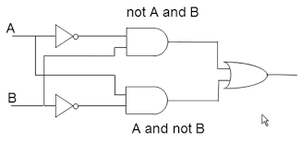
Application – Circuit Design
Propositional Logic

Slide 15
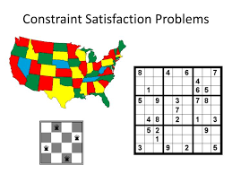
Application – Constrain Satisfaction
Propositional Logic

Slide 16

Application – Program Verification
Hoare logic
Separation logic
Temporal logic
Model checking
SAT/SMT solving

Slide 17

Application VI – Expert System
knowledge base = formula set
query = formula

Slide 18
  Content
    Classical logics
    Classical reasoning
    Modern SAT solving
    Applications
    Difficulties

Slide 19
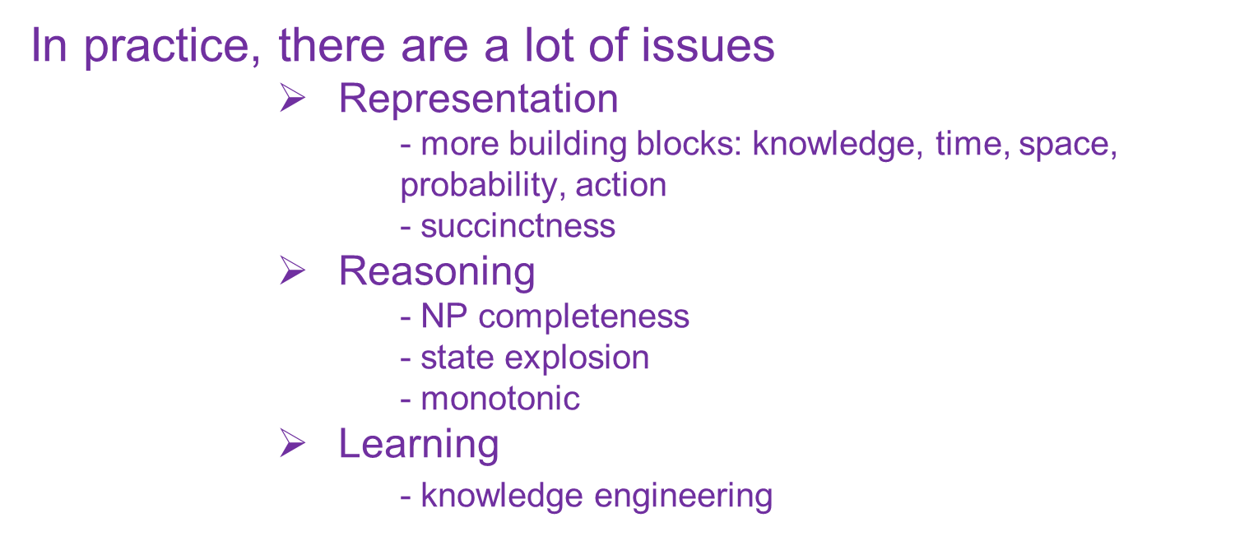
Propositional Logic for ALL
In principle, propositional logic can do almost everything

Slide 20

Thank you!

